Slide 1


DevOps first demo
Yordanka Dimanova Jekova –student in SoftServe academy

Slide 2
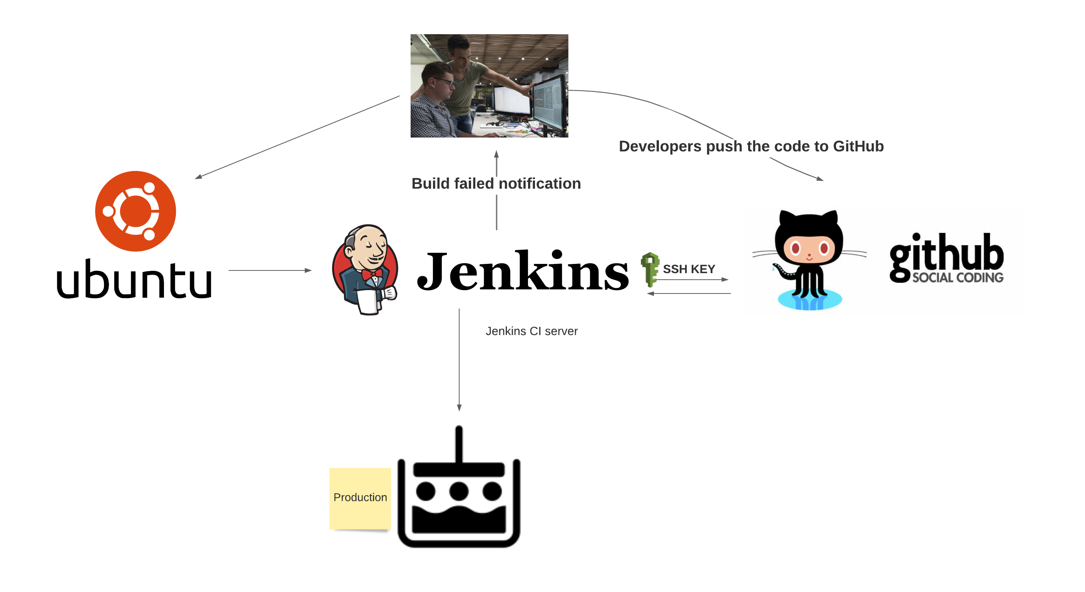

https://github.com/iordanka911/MyDemo1

Slide 3
Build steps
1. Ubunu 20.04
2. Installing and running Jenkins on Ubuntu
Configuring Jenkins
Manage Jenkins -> Manage Plugins
Generate the ssh key in Ubuntu
Copy the key in Github
Configure in Jenkins Credentials
Configure a sample job in Jenkins using SSH key
Notes:
An Amazon EC2 instance (Amazon’s Elastic Compute Cloud) for running applications on the Amazon Web Services (AWS) infrastructure.

Slide 4
Install Jenkins
wget -q -O - https://pkg.jenkins.io/debian-stable/jenkins.io.key | sudo apt-key add –
sudo apt-get update
sudo apt-get install openjdk-11-jdk
sudo apt-get install jenkins

Slide 5
Install apache2
sudo apt-get install apache2

Slide 6
What can be improved in my project?
It can be more secure
AWS EC2 instance will be added

Slide 7

Thank you for your attention

Slide 8

Q & A

Slide 9
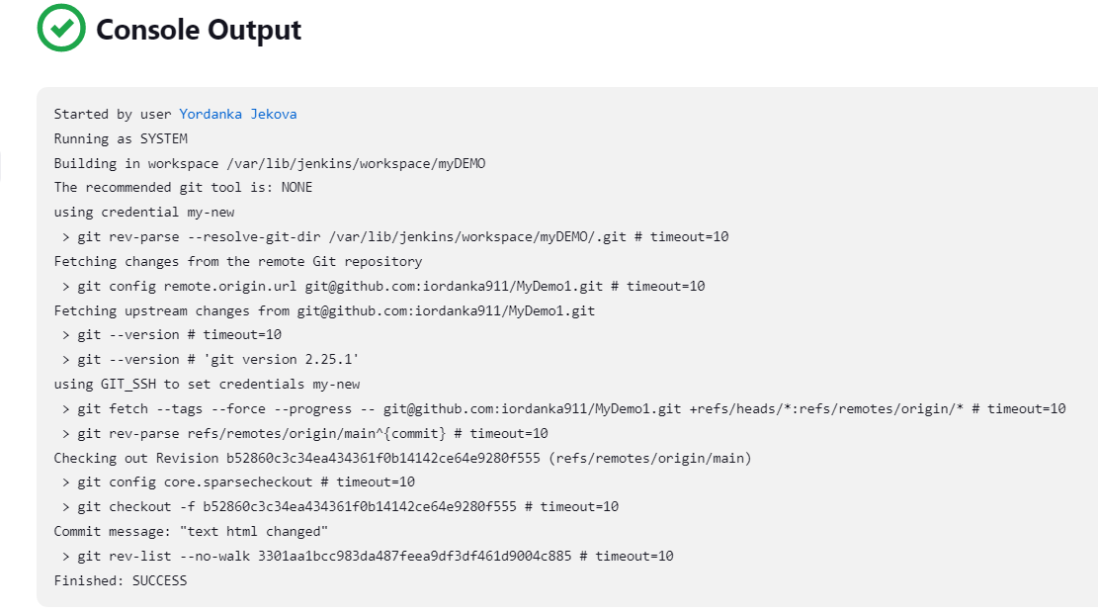

Slide 10
